Slide 1
A Hacker's Guide to C++
Presented by Aaron Hails

Slide 2
Agenda
Introduction
Tools Installation
Project Introduction
Code as We Learn
Learning Post-Workshop
Q&A

Slide 3

Self Introduction
When introducing yourself, keep it concise and relevant.
Start with a hook, state your expertise, and explain why you’re presenting.
If possible, keep your introduction to under 60 seconds to maintain interest.

Slide 4
C++ is complicated

Slide 5
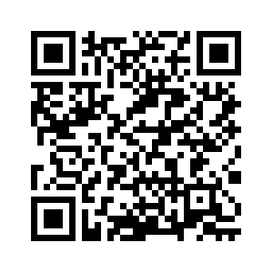
Tools installation
github.com/Auriosi/cpp-workshop/blob/main/tooling.md

Slide 6

Project Introduction
Text-based hackathon survival simulator
Player has 24 hours to complete their project
Manage time and energy to contribute as much progress as possible

Slide 7
Engagement data
Area | Impact on engagement | Source
Eye contact | 80% more audience connection | Business review
Storytelling | Increases retention by 22x | University study
Interactive polls | Leads to 34% higher engagement | LinkedIn
Visual aids | Boosts retention by 65% | Company research
Attention spans | Lasts about 5 minutes | Journal article
First impressions | Made in the first 15 seconds | Industry report

Slide 8

Why visuals matter
Studies show that 35% of an audience’s retention rate is attributed to visuals, so use these best practices.
Use high-quality images
Avoid stock photos that feel overused. Use animated images sparingly. Motion should enhance, not distract.
Leverage infographics
Present complex data in an easy-to-digest format.
Keep text minimal
Slides should support your speech, not replace it.
Use brand colors
Maintain consistency in fonts and color palettes for professionalism.

Slide 9
35%
of an audience’s retention rate is attributed to the visuals used

Slide 10
Delivering with impact
Keeping your audience engaged through effective techniques

Slide 11

Effective delivery techniques
Your delivery can make or break your presentation. Focus on the following techniques.
Voice modulation
Vary pitch, tone, and volume to emphasize key points. Pause strategically as silence builds anticipation.
Body language
Maintain open gestures and avoid crossing your arms. Move naturally. Step forward when making a strong point.
Non-verbal cues
Look for cues (like nodding and note-taking) that show that your audience is engaged.
Additional tips
Be confident, rehearse aloud, and show enthusiasm.

Slide 12
Delivering with confidence
Meaningful eye contact, purposeful gestures, and good posture can enhance your message and make it more memorable.

Slide 13
Conclusion
Start with a hook and a clear purpose. Engage your audience using eye contact, storytelling, and questions. Design slides that enhance your message, not distract. And deliver with confidence.

Slide 14

Q & A
Use this portion of your presentation to answer audience questions.

